Slide 1
Mass Media Role in Developing Character Education: A Debate
International Conference of Character Education
Yogyakarta State University
2011

Slide 2
The most influential thing in character education development is media

Slide 3



(Hancox study)
Children in 5-15 years old are the most potential target to be affected by media.

Slide 4
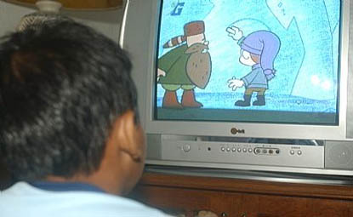
For many children, television consumes more time than any other activity except sleep (Comstok & Paik, 1991 in Pecora, Murray, and Wartela, 2007).

Slide 5
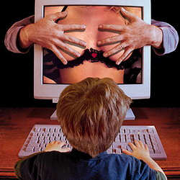
Many electronic cinemas, reality show, even cartoon programs present sexuality, violence and harshness. Previous research has proved that television influences negative effect, such as some children committed suicide after watch a certain program.

Slide 6

And….Internet

Slide 7
Contemporary, one of the greatest threats in children appears to be from the internet, with sexual predators lurking in chat rooms meant for children and pornography merely a click away (Kirsh, 2010: 2).

Slide 8
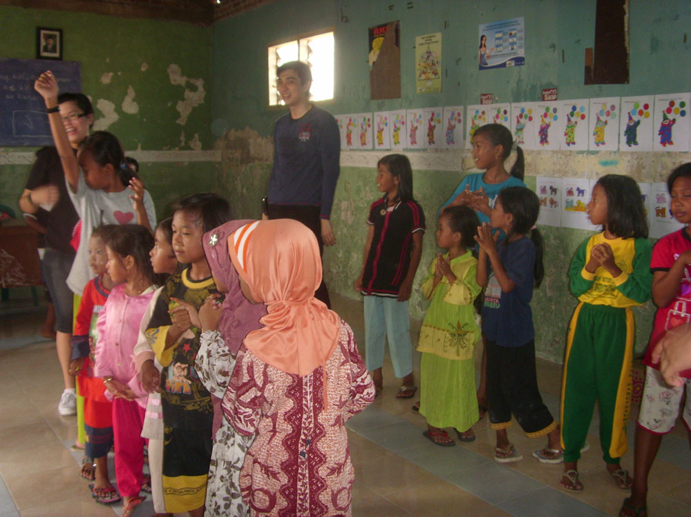
Rumah Belajar Kenjeran

Slide 9
How Media Work
All the more various programs in television or radio show an effort of media industries to reach their market entirely (Rating).
To survive → needs budget → produce something fast, interesting, and Cheap
Result → unqualified content of programs.

Slide 10
Hypodermic Needle
vs
Uses and Gratification

Slide 11
De Fleur and Dennis said that mass communication differs from face to face communication and from mediated interpersonal communication not only because it involves more complex media, but also because the audience is large and diverse (De Fleur and Dennis, 1994: 30).

Slide 12
Media effect perspective emphasize that media have impact on its users.
The first theory presented is hypodermic needle or magic bullet theory. This theory states that media consumption affects everyone, and everyone is affected by media in pretty much the same way (Sparks, 2001 in Kirsh, 2010).

Slide 13
On the opposite, according to the ‘uses and gratification’ perspectives, enjoyment is the key to understand media consumption. Although the needs of youth are many and varied, multiple “uses” and associated “gratification” of media consumption have been identified. (Sparks, 2001 in Kirsh, 2010).

Slide 14
Character education is functioned to prevent more various social problems among youth.
Unfortunately, as media has been developed, many challenges have to be faced by character education.

Slide 15
Media Literacy: A Key to Break the Debate

Slide 16
The debate of mass media role in character education development cannot be averted.
All needed both for parents and teacher to accomplish character education is to equip the children with literacy on media.

Slide 17
Media literacy is a set of perspectives that we actively use to expose ourselves to the media to interpret the meaning of the messages we encounter (Potter, 2008).

Slide 18
On the typology of media literacy, it is said that there are some stages:
acquiring fundamentals things about human, shape, color,
movements on mass media;
language acquisition, such as recognize speech and sound, reproduce speech and sound;

Slide 19
narrative acquisition, like develop understanding of differences, fiction or nonfiction;
developing skepticism, discount claims made in ads, sharpen difference between like and dislike;
intensive development; experiential exploring; critical appreciation; and social responsibility (Potter, 2007).

Slide 20
The debatable role of media cannot be circumvented.
We have to take advantage of media to develop character education trough media literacy.

Slide 21
Senator William Fulbright:
Education is slow moving but powerful impact

