Slide 1
Solar Passive and
Energy Efficient Building
Good Practices
From Petra Christian University

Slide 2
Outline of Presentation
Why Energy Efficient in Buildings?
Evolution of Energy Efficient in Buildings
Examples of Energy Efficient Buildings
Conclusion

Slide 3
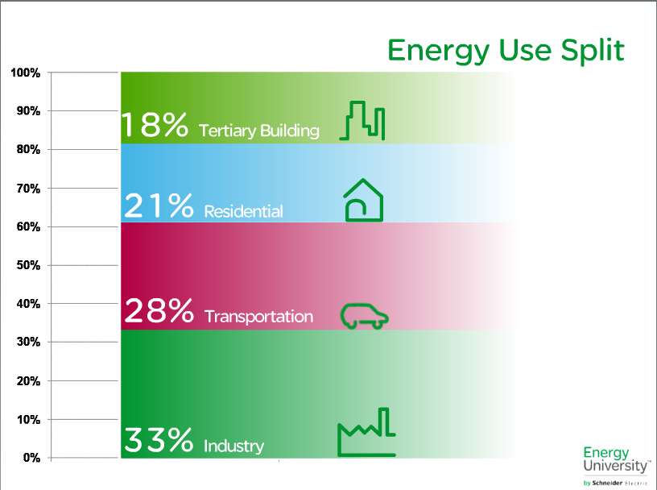
How much Energy spent in Buildings?

Slide 4
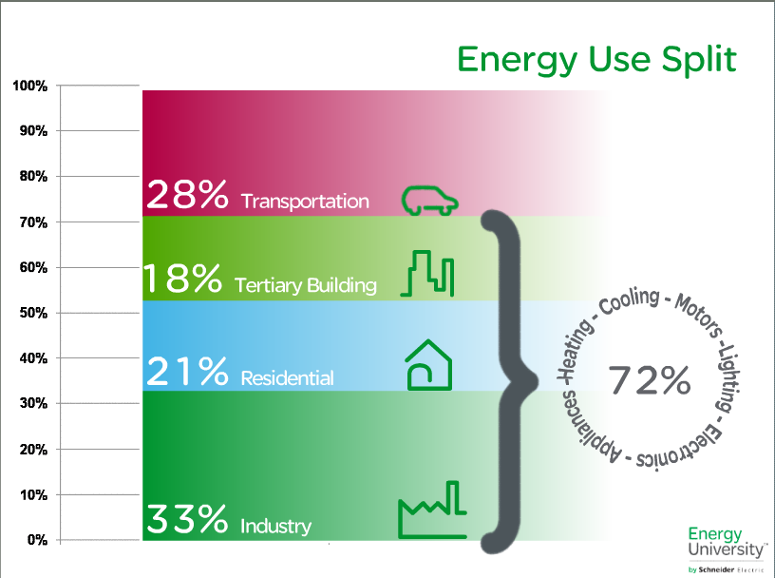
How much Energy spent in Buildings?

Slide 5
Aspects of Energy Conscious Design
Thermal Comfort aspect.
  Heating and Cooling system
Visual Comfort aspect.
  Lighting system
Reference: Jimmy Priatman, Energy Efficient Architecture, Oct 2011

Slide 6
Evolution of Energy Efficient in Building Design *)
Pre- Industrial Era (before 1800 AD)
Industrial Age (1800 – 1980 AD)
Post- Industrial Era (1980 – 2000)
Global Era (2000 – present)
*) Reference: Jimmy Priatman, Energy Efficient Architecture, Oct 2011

Slide 7
Constrains in Design
ERA | Resources | Technology
Pre-industrial (before 1800) | Abundant | Limited
Industrial Age (1800 – 1980) | Abundant | Innovative [AC, Lamps, Elevators]
Post Industrial (1980 – 2000) | Limited | Developed [energy efficient appliances]
Global Era (2000 – present) | Depleted | Advanced [renewable energy]
Reference: Jimmy Priatman, Energy Efficient Architecture, Oct 2011

Slide 8
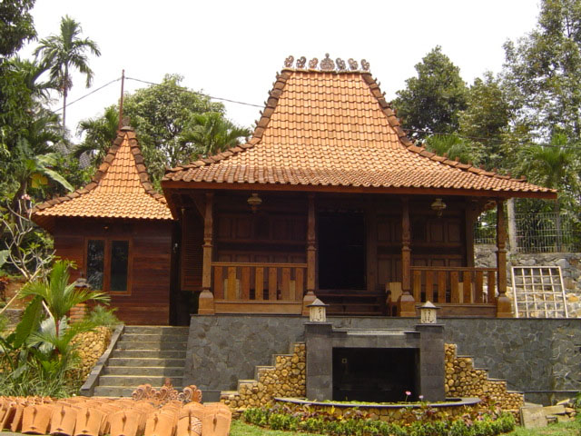
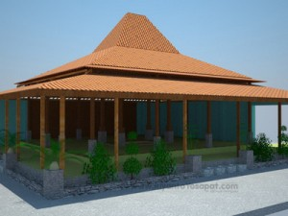
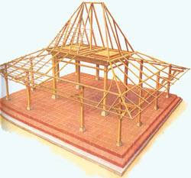
Pre-Industrial

Slide 9
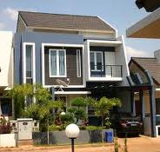
Industrial Age
Thermal Comfort:
Air Conditioning system
Visual Comfort:
Lamps

Slide 10
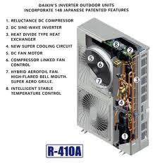
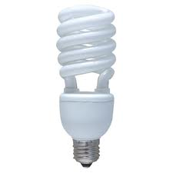
Post Industrial

Slide 11
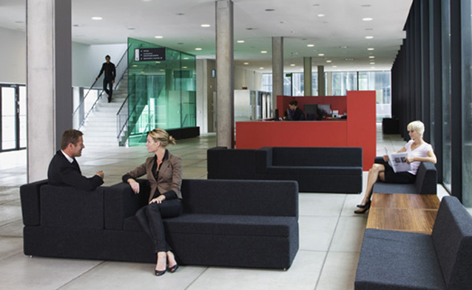
Global Era
Building Automation System.

Slide 12
Three method of Control
Passive Environmental Control
A design of utilizing the local climate controlled by building elements (roof, wall, floors, etc) without the help of electricity
Active Environmental Control
A design that using technology and electrical instruments to achieve the thermal and visual comfort
Hybrid Environmental Control
First priority: Passive control,
then hybrid and active control.

Slide 13
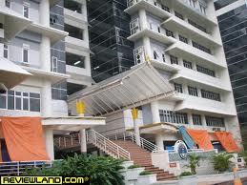
Good Practices from
Petra Christian University

Slide 14
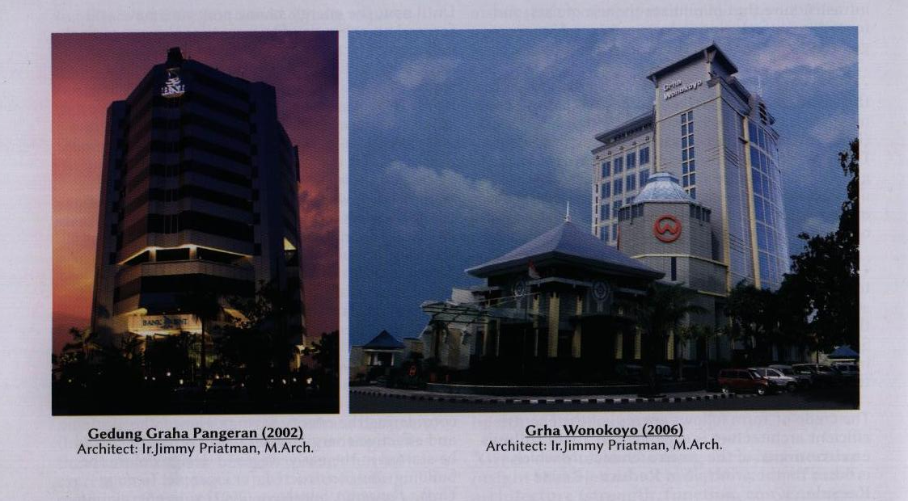
Best Practice - 1
EEI = 88 KWh/m²/yr
EEI = 144 KWh/m²/yr
Minimum Natioan EEI = 200 KWh/m²/yr

Slide 15
Factor of success
Orientation of building
Layout of rooms
Wall Windows ratio
Material for building’s envelope.
Energy saving equipments (Air Con and Lamps)

Slide 16
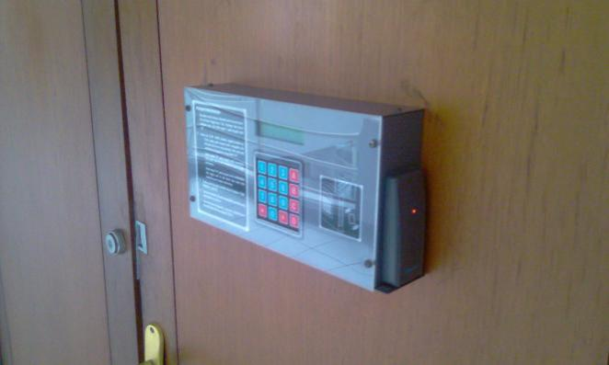
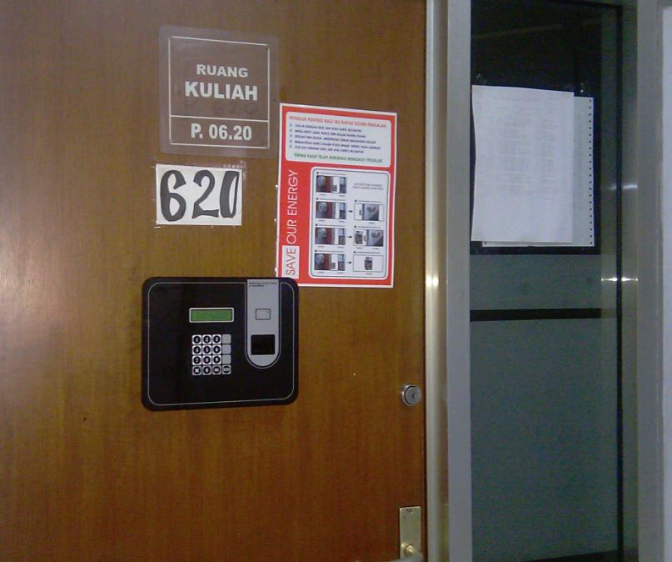
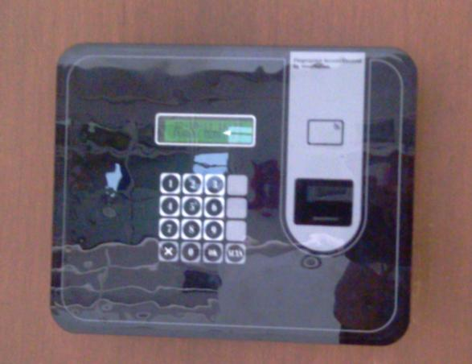
Best Practice - 2

Slide 17
No significant result

Slide 18
Possible reasons
Human behavior.
Lecturer “forgets” to bring their card.
[now it is changed with finger ID]
Classroom occupancy is already high.
There are other loads that are more significant than AC and lamps in the class rooms.

Slide 19
Good Practice - 3
House | Lux
Porch | 60
Living Room | 120 - 250
Dining Room | 120 - 250
Working Room | 120 - 250
Bed Room | 120 - 250
Bath Room | 250
Kitchen | 250
Garage | 60

Slide 20
Good Practice - 3
Rooms in school | Lux
Class Room | 250
Library | 300
Laboratory | 500
Drawing Room | 750
Canteen | 200

Slide 21
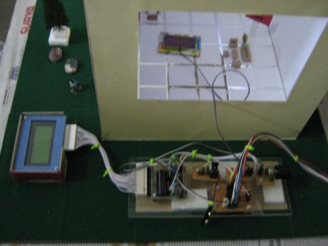
Good Practice - 3
Smart Lamp
Solar Cell for light sensor
LED
PWM
[7.8 KHz]
ATMega8

Slide 22

Good Practice – 4
Petra’s Green Building [2014]
“V” Shaped
Energy Park:
  Solar Cell on top of the roof
  Wind Turbine inside the “V” tunnel
Water conservation system

Slide 23
Conclusion
Energy Efficient Building design should prioritize in Passive Environmental Control before applying the Active as well as Hybrid Environmental Control
Human behavior and psychological barrier should be considered.
Building Automation System could be an additional enhancement for EE Buildings

Slide 24


